Slide 1


Logic Model Creation and Refinement
Ben Koo
Tsinghua University
benkoo@tsinghua.edu.cn

Slide 2
Back-
ground
Describe a Situation’s Temporal and Spatial Context that deserves deliberate project-based actions or the incorporation of an active organization
Goal
An imperative statement that clarify the objectives of planned actions or a proposed organization, given the situations presented in the Background section
Outcome
Output
Activities
Input
Offer the indicators and criteria for desirable outcomes
The indicators and criteria should be multi-faceted and complementary, so that they together ensure meaningful success
Descriptions of desirable outcome should be composed of qualitative and quantitative conditions
Outcome statements should form the basis for OUTPUT (deliverables)
Specify the concrete information content or physical evidence as the measurable effects of the program’s activities。
Witness accounts, evidence of effects
Process data generated by participants of the program
Measurable differences of capabilities, ideas, and other programs.
Project reports, Analysis Reports, Business Proposals, or other types of summative documentation
A list of essential activities in the project or organization
Schedule and priorities
While activities are taking place, state how and what process data can be captured for future analysis
Intermediate Review Meeting with the sponsoring advisors
Interactions with the target service/product audience
Online and offline interaction activities
Initial “Logic Model”
A constitution for the project/organization
Participation Model
Responsibilities
Amendment Process
Infrastructures, equipment, communication bandwidth
Budget
Data and Computational Resources
Logic Model: The Contract of your work
Boundary Conditions
As project proceeds, the content of a Logic Model must be updated, therefore, the speed and consistency of propagating updates is of critical importance. A key reason for keeping Logic Model simple, is to ensure that the amount of time required to refine and transmit Logic Model to its participants is relatively small, therefore, we can increase the speed and consistency of the latest version of Logic Model.

Slide 3
Back-
ground
1
Describe a Situation’s Temporal and Spatial Context that deserves deliberate project-based actions or the incorporation of an active organization
2
Goal
An imperative statement that clarify the objectives of planned actions or a proposed organization, given the situations presented in the Background section
Outcome
Output
Activities
Input
Offer the indicators and criteria for desirable outcomes
The indicators and criteria should be multi-faceted and complementary, so that they together ensure meaningful success
Descriptions of desirable outcome should be composed of qualitative and quantitative conditions
Outcome statements should form the basis for OUTPUT (deliverables)
Specify the concrete information content or physical evidence as the measurable effects of the program’s activities。
Witness accounts, evidence of effects
Process data generated by participants of the program
Measurable differences of capabilities, ideas, and other programs.
Project reports, Analysis Reports, Business Proposals, or other types of summative documentation
A list of essential activities in the project or organization
Schedule and priorities
While activities are taking place, state how and what process data can be captured for future analysis
Intermediate Review Meeting with the sponsoring advisors
Interactions with the target service/product audience
Online and offline interaction activities
Initial “Logic Model”
A constitution for the project/organization
Participation Model
Responsibilities
Amendment Process
Infrastructures, equipment, communication bandwidth
Budget
Data and Computational Resources
Logic Model: The Contract of your work
3
4
5
6
7
Boundary Conditions
As project proceeds, the content of a Logic Model must be updated, therefore, the speed and consistency of propagating updates is of critical importance. A key reason for keeping Logic Model simple, is to ensure that the amount of time required to refine and transmit Logic Model to its participants is relatively small, therefore, we can increase the speed and consistency of the latest version of Logic Model.

Slide 4
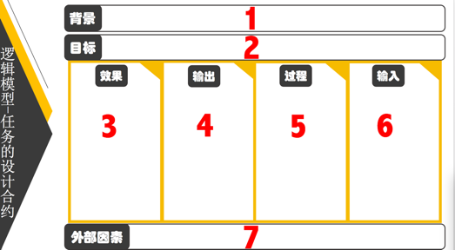
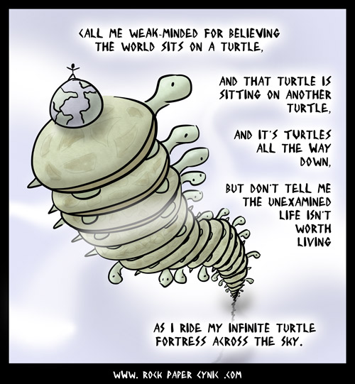
Sequence
Starting with Background、do NOT start with Input.
Follow the sequential number, filling up the seven boxes.
Each box represents one layer of your understanding of the overall system at hand
Your understanding is reflected through your choice of words.
It is necessary to iteratively refine your statements in each box. (Starting from background.)

Slide 5
Background
Logic Model is a tool for inspecting and reviewing project proposals by the Office of General Accounting of the United States of America. It is also used by United Nations
This document is a required communication instrument BEFORE any project starts.
A description of background should portrait a pain point, a situation where something must be done to avoid disaster or to ensure forseeable success.

Slide 6
Sample Background Statements：
In the last ten years, the average GPA of university graduates are constantly increasing, but the employment rate and employability indices are dropping rapidly.
In XYZ vocational school, more than 20 percent of students skip hand-on classes, and many skips classes in general, but the graduation rate is nearly 100 percent, and their starting salary are also increasing.
Note that certain time and categorization of target persons are explicitly stated in Background.

Slide 7
Goal
A concise mission statement, covering multiple layers of objectives
Example：
Background: In XYZ vocational school, more than 20 percent of students skip hand-on classes, and many skips classes in general, but the graduation rate is nearly 100 percent.
Goal：Improve the content and qualification process of hand-on classes in XYZ vocational school, ensure graduating students must have proper professional skills and adequate social conduct.

Slide 8
Desirable Outcome
Multiple interrelated outcome statements，explicitly qualify complementary conditions to ensure the outcomes matches the goal
Example：
Goal：Improve the content and qualification process of hand-on classes in XYZ vocational school, ensure graduating students must have proper professional skills and adequate social conduct.
Outcome：
Require students to pass a series of third-party professional skill qualification service before graduation
Establish a privacy-protecting learning process data recording system for class attendance, so that students can demonstrate and present their formative records to potential employers without exposing privacy。

Slide 9
Output
The Outcome statements should be satisfied by at least one Output item
Example：
Outcome：
Require students to pass a series of third-party professional skill qualification service before graduation
Establish a privacy-protecting learning process data recording system for class attendance, so that students can demonstrate and present their formative records to potential employers without exposing privacy。
Output：
Third Party Skill Verification Service and Examination Material/Process
Student’s Learning Process Data collected and Protected by Secure Data services

Slide 10
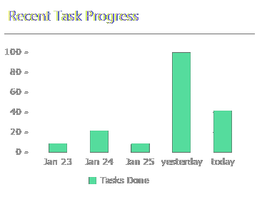
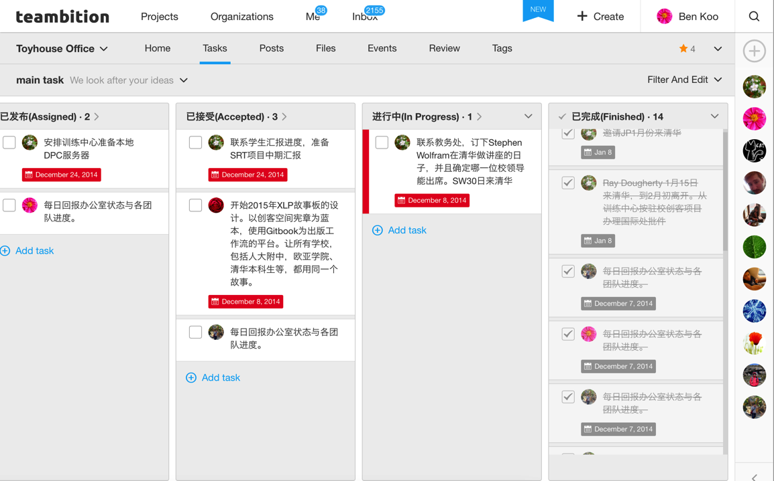
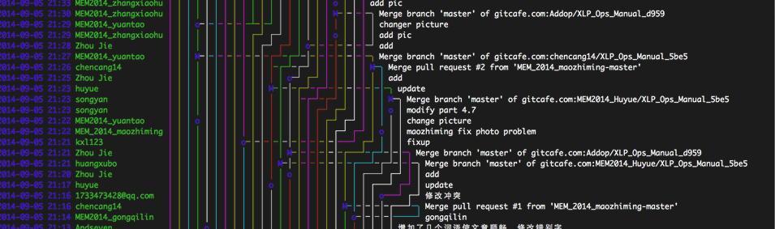
ABC Learning Process Data is a kind of Output

Slide 11
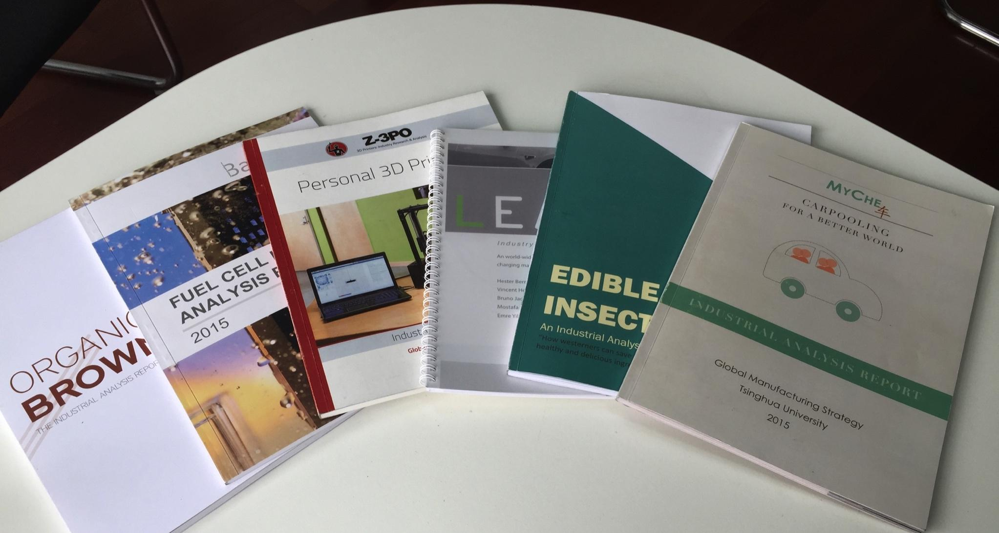
Paper-based Publication is a kind of output
Notes:
14

Slide 12
(Organized) Activities：The methods of that creates output
Based on the Output, Define relevant Activities that would deliver the output
Example：
Output：
Third Party Skill Verification Service and Examination Material/Process
Student’s Learning Process Data collected and Protected by Secure Data services
Activities:
Review 3rd Party Examination Services, Select the most reliable service agency or agents
Select the What Data to collect
Choose how to Collect Data
Data Collection Technology
Data Privacy Protection Technologies

Slide 13
Input
Given the Activities, identify the required resources to conduct the activities:
Example：
Activities:
Review 3rd Party Examination Services, Select the most reliable service agency or agents
Select the What Data to collect
Choose how to Collect Data
Data Collection Technology
Data Privacy Protection Technologies
Input:
A list of available 3rd Party Professional Skill Qualification Services
Learning Process Data analysis experts
Learning Process Data collection experts

Slide 14
Boundary Conditions
Enumerate any conditions that might invalidate the assumptions of the project.
Example：
Students share their passwords, confounding data collected
Participants do not use the data collection device, not enough data can be collected in time
Due to smog, students are asked to not attend classes in general

Slide 15
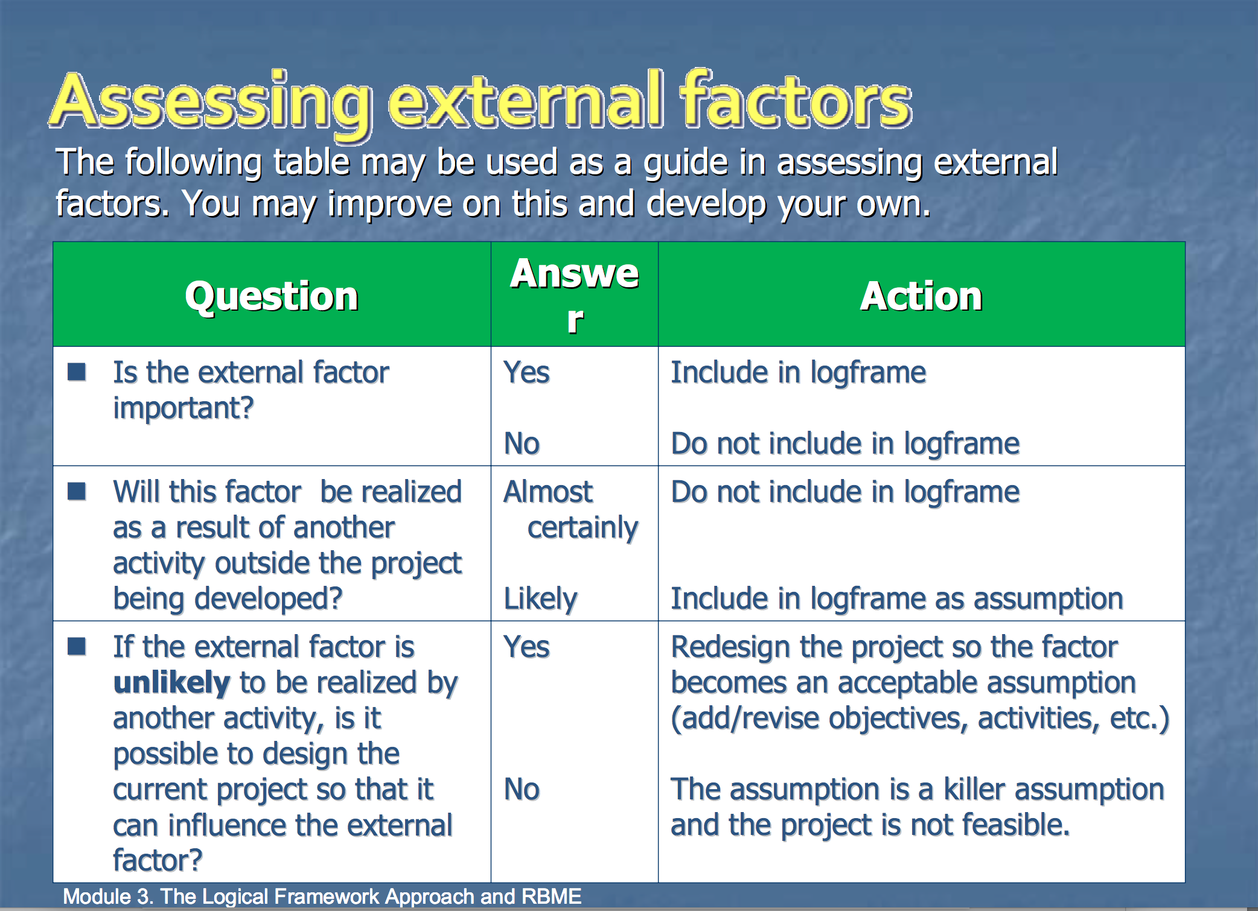
Assessing external factors

Slide 16
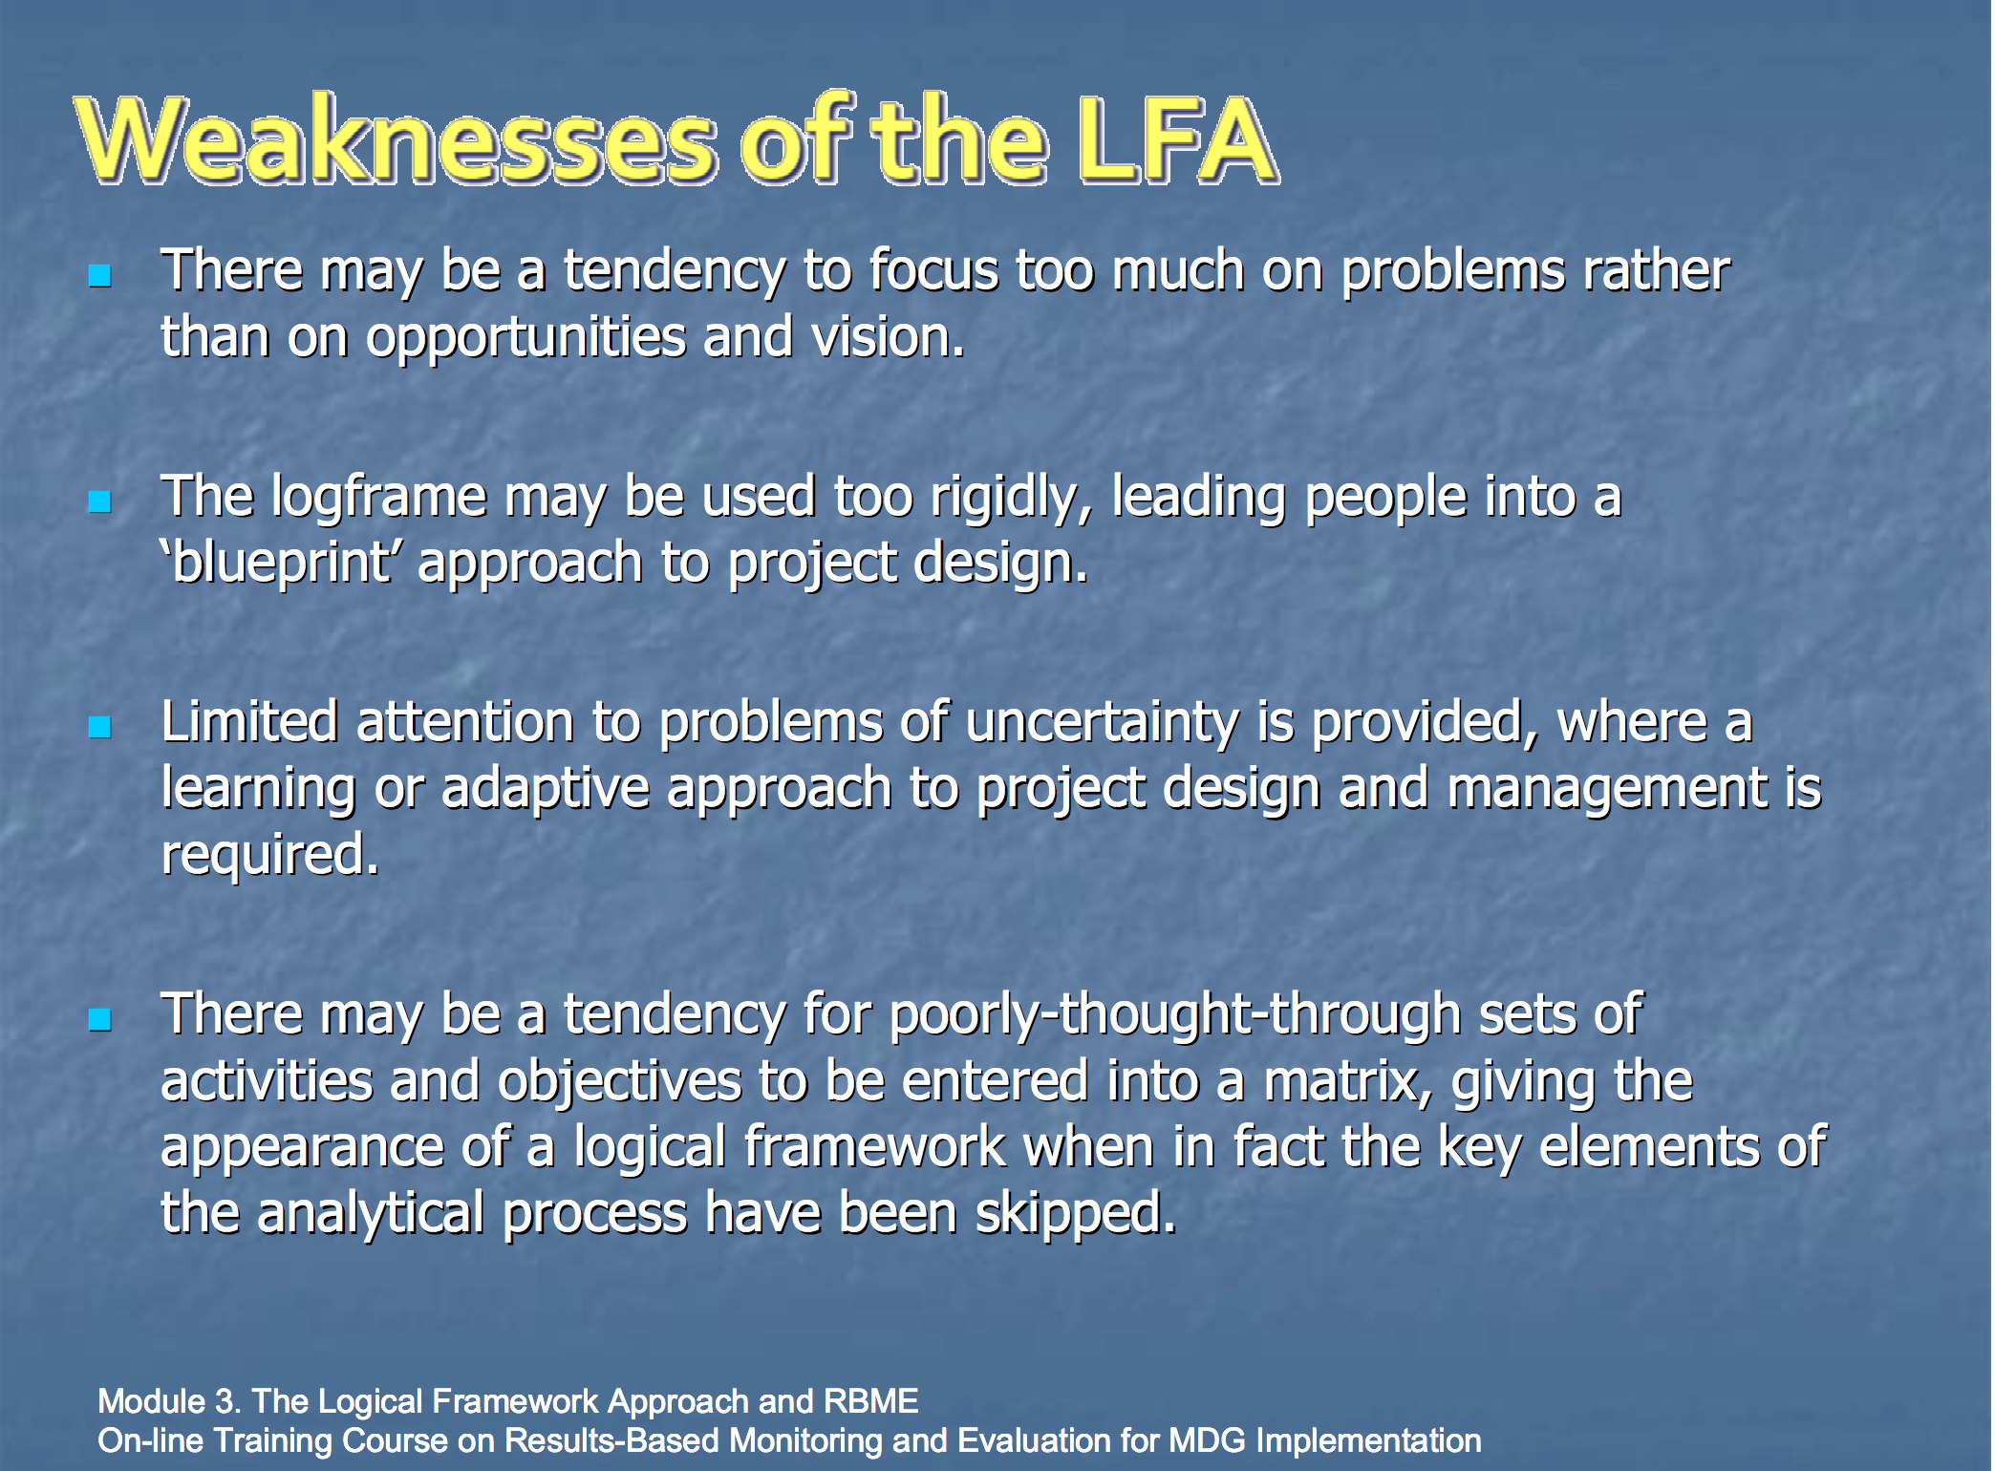
Weaknesses of the Logic Model

Slide 17
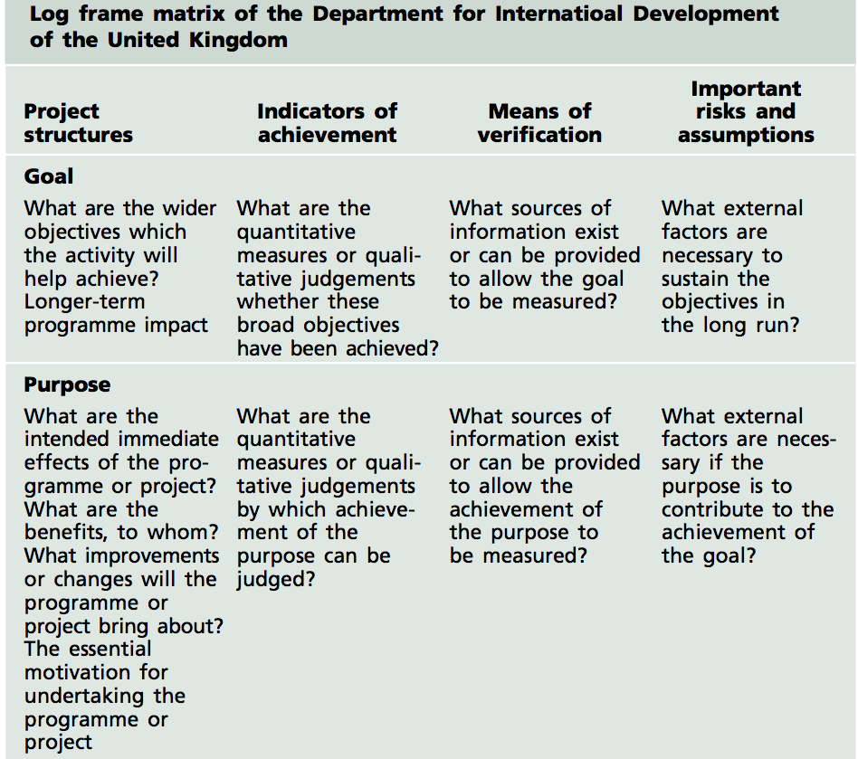
Logic Frame of the UK

Slide 18
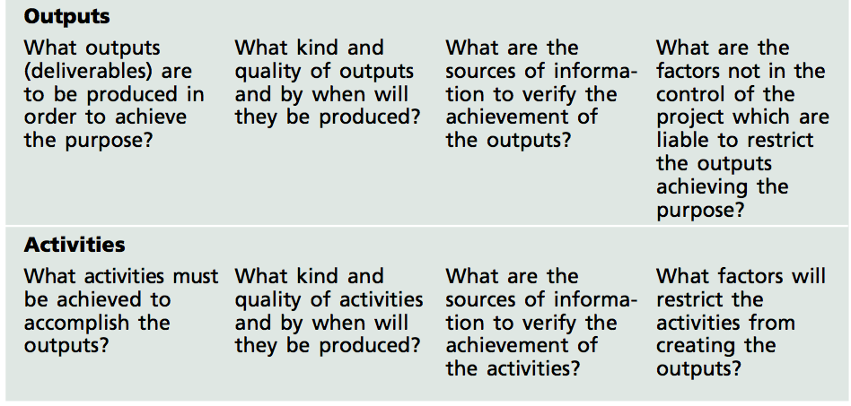
Logic Frame of the UK

Slide 19
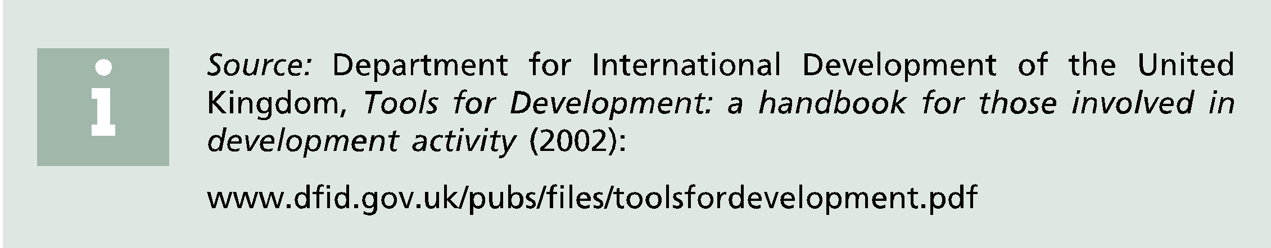
Logic Frame of the UK

Slide 20
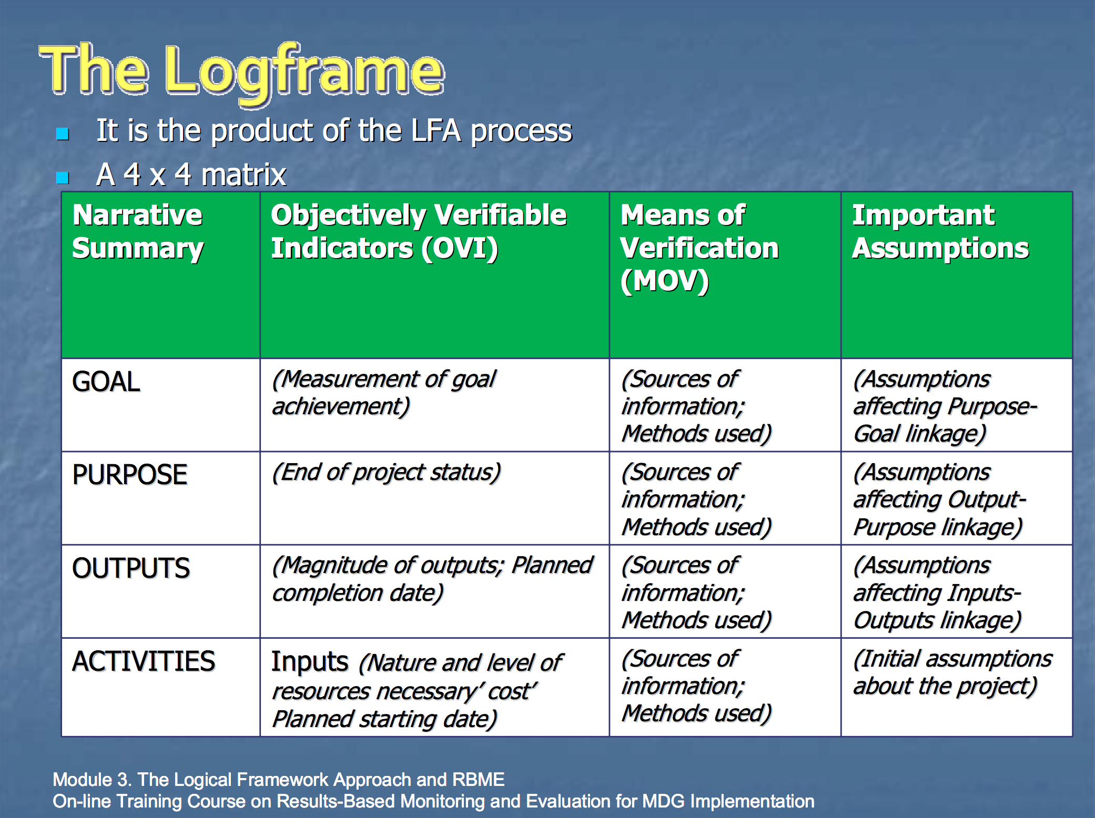
The LogFrame

Slide 21
A reminder of the Goal for AESP 2017
Example：
Background: On March 6, 2017, a group of China-UK students have spent over 3 months creating at least 10 Business Plans...
Goal：Improve the content and presentation of existing Business Plans, so that all plans are ready to be served to Dragons in iCenter’s Den on Friday, March 10, 2017.

Slide 22
Reference Material
General Accounting Office, Program Evaluation Strategies for Assessing How Information Dissemination Contributes to Agency Goals, last accessed: Jan 21st, 2021
David Allen, Getting Things Done: The Art of Stree Free Productivity, Penguin Books, Revised Edition, 2015, p. 163~169
Department for International Development of the United Kingdom, Tools for Development: a handbook for those involved in development activity (2002):
Electronic Resource: The Logic Frame Approach http://unpan1.un.org/intradoc/groups/public/documents/UN/UNPAN032814.pdf Last Accessed: March, 6, 2017

Slide 23
Q&A

